Slide 1
High voltage mini project
Søren Hadberg, Rólant J. Olsen, Fitim Kryezi, Mikael K. Sørensen & Ragnar Sigurbjörnsson

Slide 2
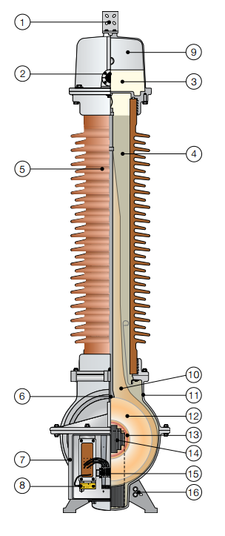
Inductive voltage transformer
Primary terminal
Oil level sight glass
Oil
Quartz filling
Insulator
Lifting lug
Secondary terminal box
Neutral end terminal
Expansion system
Paper insulation
Tank
Primary windings
Secondary wndings
Core
Secondary terminals
Ground connections
Installation | Outdoor
Insulation | Oil-paper quartz
Highest voltage for equipement | 72.5
Voltage factor | Up to 1.9 for 8 hrs
Insulators | Porcelain
Creepage distance | ≥ 25 mm/kV
Service conditions: Ambient temperature | -40°C to 40°C
Design altitude | Maximum 1000 m
LIWV | 325 kV
Notes:
The unique quartz filling minimizes the quantity of oil and
allows a simple and reliable expansion system.
Low flux in the core at operating voltage gives a wide
safety margin against saturation and ferro-resonance which is an oscillation between the
inductive voltage transformer and the network

Slide 3
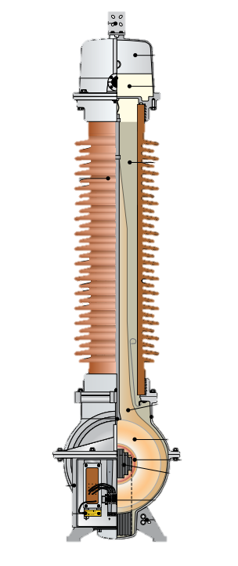
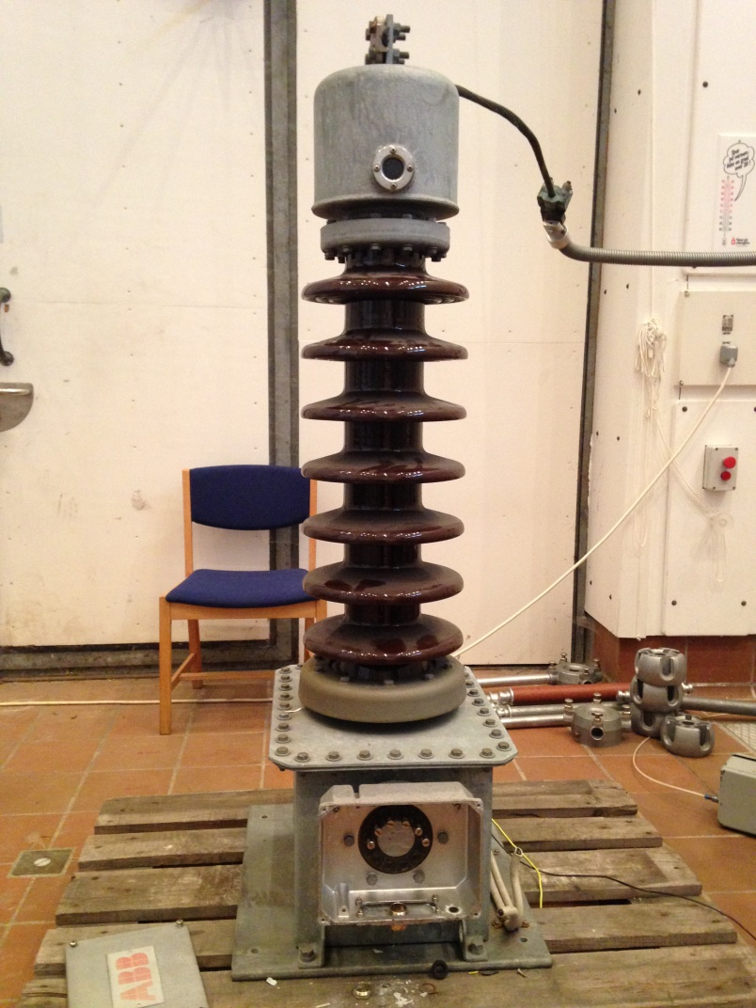
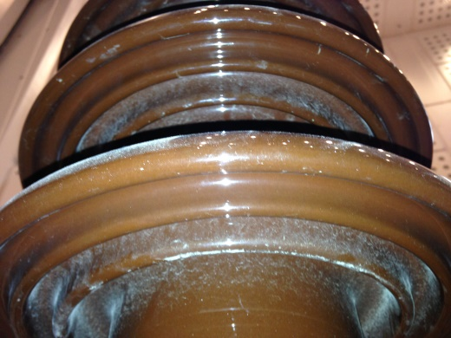

Slide 4
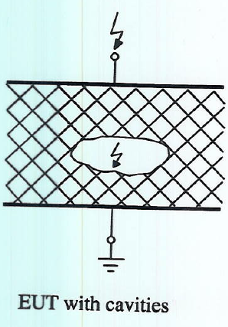
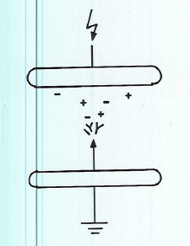
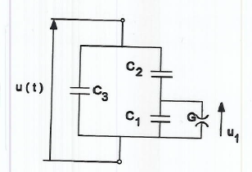
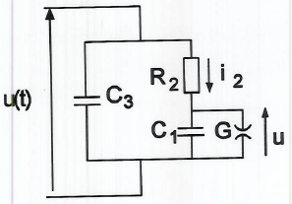
Partial discharges
Notes:
When we need to measure the condition of the dielectric material it is important to classify the condition of the dielectric material without destroying the component. To do so, one can measure partial discharges. Partial discharges can be damaging to the dielectric material, as the ions recombine. For instance ozone, which is a highly corrosive gas.

Slide 5
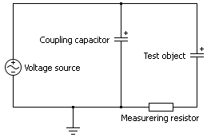
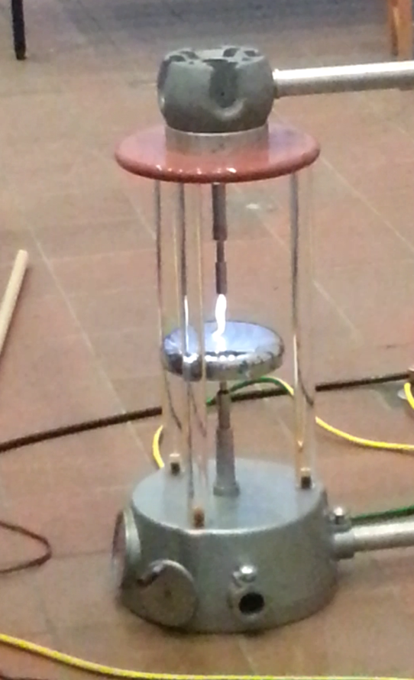
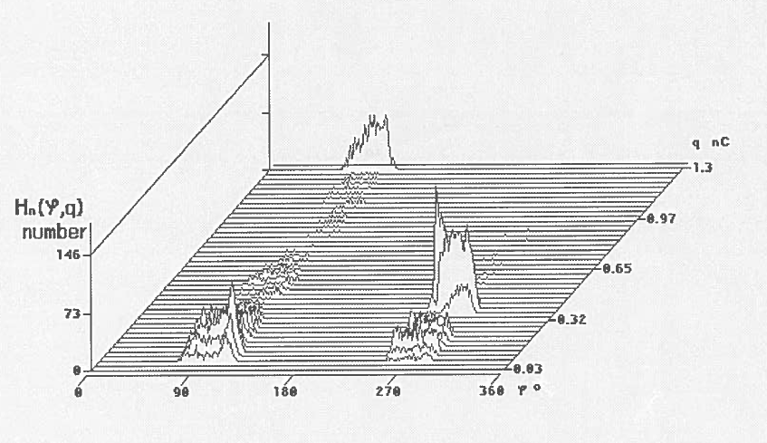
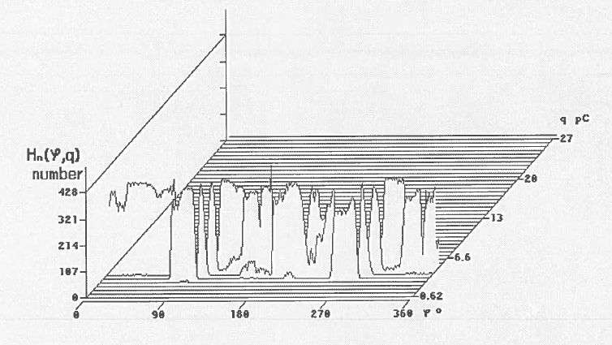

Slide 6
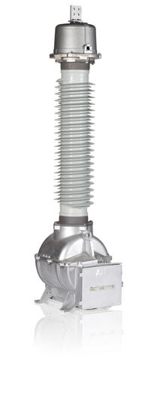
Transfer Ratio
The primary winding of the transformer is connected directly to the high voltage source transformer via aluminium conductors
Output voltage measured at secondary winding of transformer using a multimeter

Slide 7


Transfer Ratio
Transfer Ratio of a
Ideal transformer
$$\frac{V_{p}}{V_{s}}=\frac{N_{p}}{N_{s}}=n$$
Rated transfer ratio
$$n_{r}=\frac{60000}{110}=545$$

Slide 8
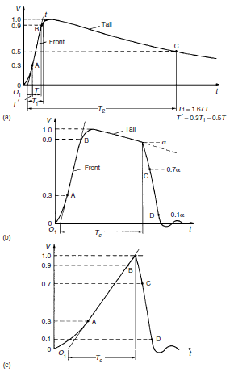
Lightning Overvoltage test
What causes the overvoltage
- Lightning stroke on OH
- Caused by switching
Figure 1 General shapes and definitions of lightning impulse (LI)
(a)Full LI (b) LI chopped on the tail (c)LI chopped on the front.
T₁: front time T₂: time to half-value T_{c}: time to chop o₁: virtual origin

Slide 9

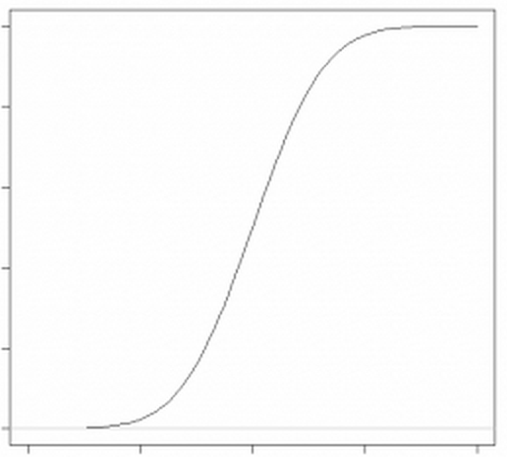
Calculating other discharges
P is the probability of discharge
V is the applied voltage
σ is the standard deviation
V₅₀ is 50 % probability of discharge
Can calculate for any voltage if V₅₀ and σ are known.

Slide 10
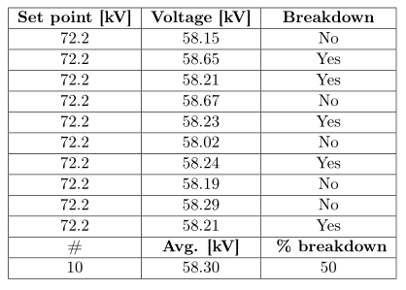
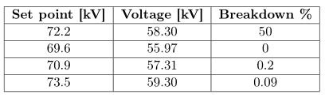
Overvoltage test
Notes:
In order to find out how much voltage a given system can handle before an arc flash event happens, an overvoltage test can be made.

Slide 11
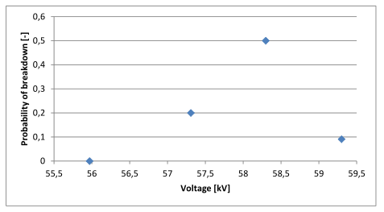
Results
Notes:
After a certain number of arc flashes, the points themselves could have changed shape, they could become slightly rounder and thus increasing the voltage needed to generate and arc flash.

Slide 12
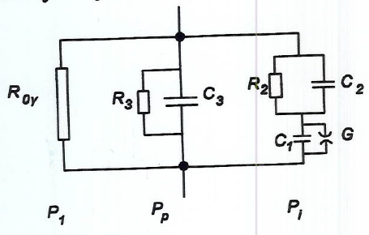
Dielectric Loss Angle
What is it?
Non destructive HV test.
Importance of it?
Dielectrics and isolating materials can be characterized by its natural polarization phenomena
Derivation of it?
Equivalent circuit to derive the (C) and (tan δ)
A
Equivalent circuit representation Physics phenomena

Slide 13
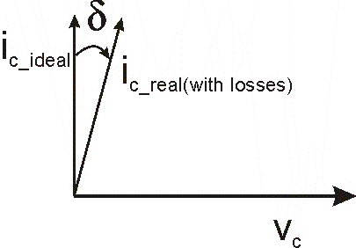

Dielectric Loss Angle
(tan δ) as ratio of active vs reactive current
$\tan{φ}=\frac{I_{w}}{I_{wl}}=\frac{P_{diel}}{Q}$
Pdiel = P1+Pp+Pi

Slide 14
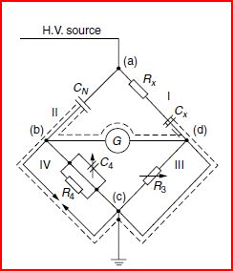
Dielectric Loss Angle
Measure of (C) and (tan δ) by comparing with Cn
By adjusting C4 and R3

Slide 15
Dielectric Loss Angle
Voltage transformer Vs Capacitor
kV | tg_d | C_x (pF) | Ix (uA)
5 | 0,2689 | 58,18 | 93,3
10 | 0,089 | 77,756 | 249
14,65 | 0,0207 | 85,638 | 394,5
19,84 | -0,0232 | 89,955 | 560,5
24,53 | -0,0488 | 91,5 | 705,6
29,82 | -0,0659 | 91,41 | 857,8
34,55 | -0,07195 | 89,502 | 972,2
39,66 | -0,062 | 84,135 | 1,05
44,45 | -0,0095 | 73 | 1,021
kV | tg_d | C_x (pF) | Ix (uA)
2,51 | 0,02035 | 19,826 | 15,65
5,03 | 0,02 | 19,874 | 31,5
7,57 | 0,0204 | 19,9 | 47,35
10,1 | 0,0208 | 19,924 | 63,1
12,58 | 0,02048 | 19,33 | 79
15,14 | 0,02065 | 19,943 | 94,985
17,13 | 0,0214 | 19,955 | 107,575
19,7 | 0,0215 | 19,961 | 123,75

Slide 16
Spectroscopy test
Dielectric response measurments in frequency domain.
Cellulose insulation(paper, pressboard)
Oil
Interfacial polarization effect
Notes:
Freq = 100 μHz to 1000 Hz
Since especially the low frequencies reflect water concentration, their
measurement is of outmost importance for reliable data analysis.
This frequency span over 7 decades enables for
discrimination between different effects and finally allows for the determination of moisture
in the solid insulation.

Slide 17
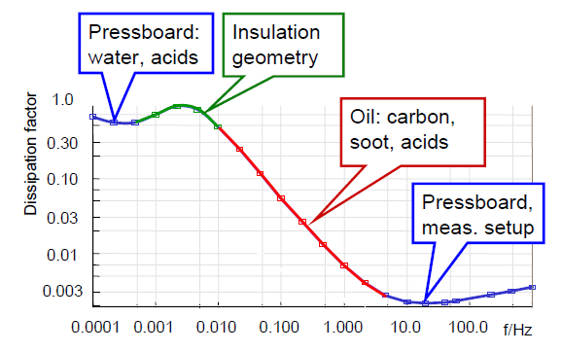
Dissipation factor
Notes:
Dissipation factor of pressboard and oil together with the interfacial polarization effect
(insulation geometry)
1. The frequency range of 1000 - 10 Hz is dominated by the cellulose insulation effect
2. The frequency range of 0.01 - 10 Hz is dominated by the oil conductivity effect
3. The frequency range <0.01 Hz is dominated by insulation geometry, ratio of oil to pressboard and moisture

Slide 18
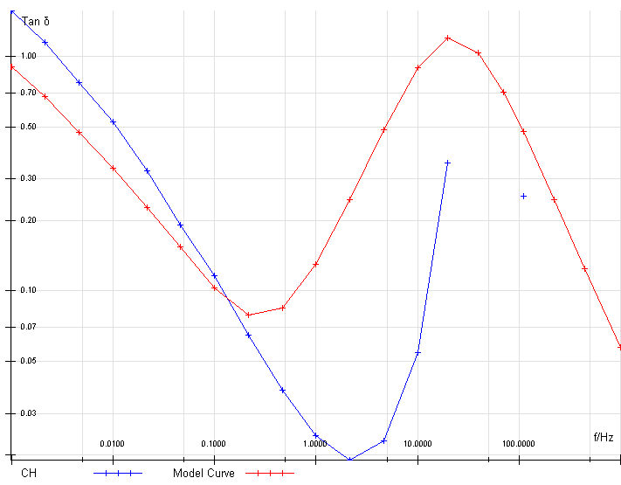
Actual spectroscopy test

